Slide 1

Safeguarding Your Digital Footprint: Recognizing and Avoiding Phishing Attacks

Slide 2


Safeguarding Your Digital Footprint
Explore the importance of understanding and protecting your digital footprint in the modern digital landscape.

Slide 3
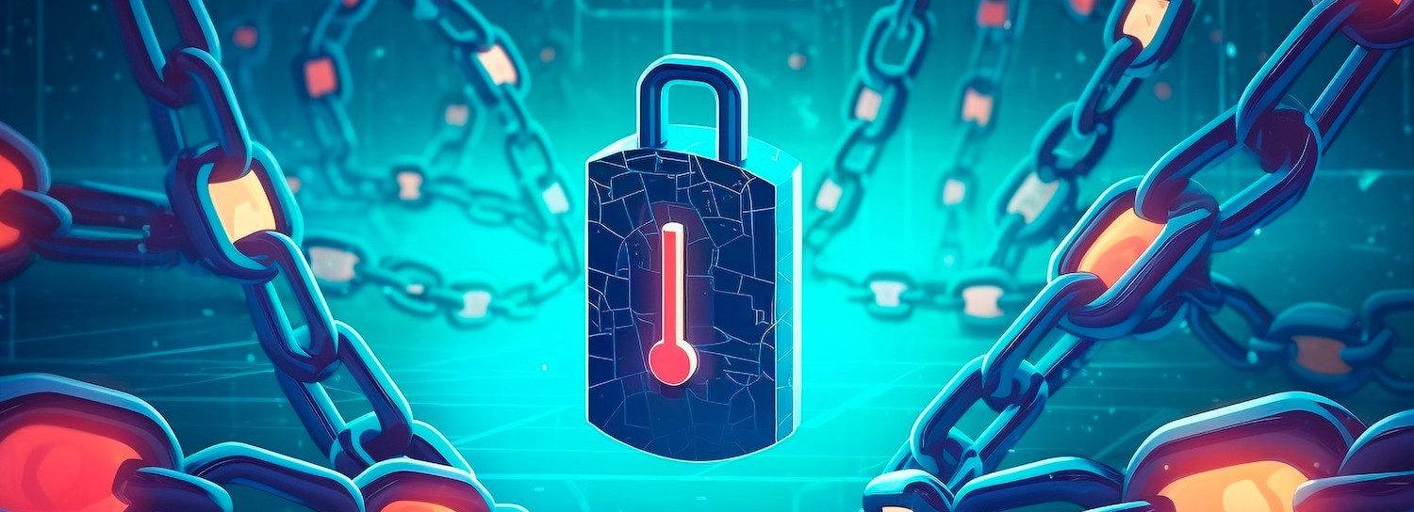
Understanding Phishing Attacks
Discover the common tactics used in phishing attacks, including email spooﬁng, fraudulent websites, and social engineering techniques.

Slide 4


Recognizing Phishing Attempts
Learn how to identify suspicious email characteristics, such as urgency, generic greetings, and questionable sender addresses, that may indicate a phishing attempt.

Slide 5

Protecting Against Phishing
Explore best practices for email veriffication, password management, and cybersecurity awareness to safeguard your digital accounts and personal information.

Slide 6

Avoiding Malicious Links and Attachments
Understand the risks associated with clicking on suspicious links and opening unknown attachments, and learn how to safely handle such content.

Slide 7

Securing Your Online Accounts
Discover the importance of strong passwords, two- factor authentication, and regular account updates to enhance the security of your digital accounts.

Slide 8

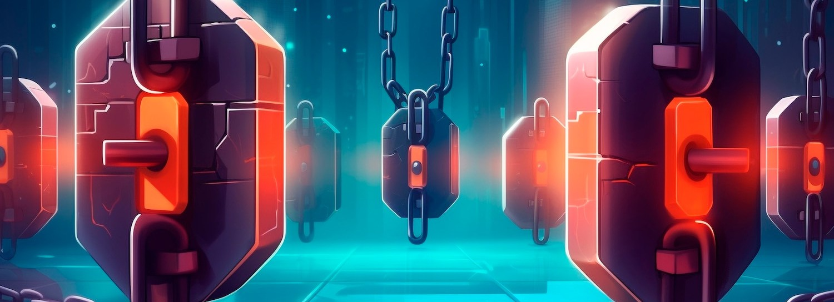
Staying Vigilant in the Digital Age
Recognize the evolving nature of phishing tactics and the need for continuous cybersecurity education to maintain a robust defense against these threats.

Slide 9

Reporting Phishing Attempts
Learn how to report suspicious emails and activities to the appropriate authorities and organizations to help combat the spread of phishing scams.

Slide 10
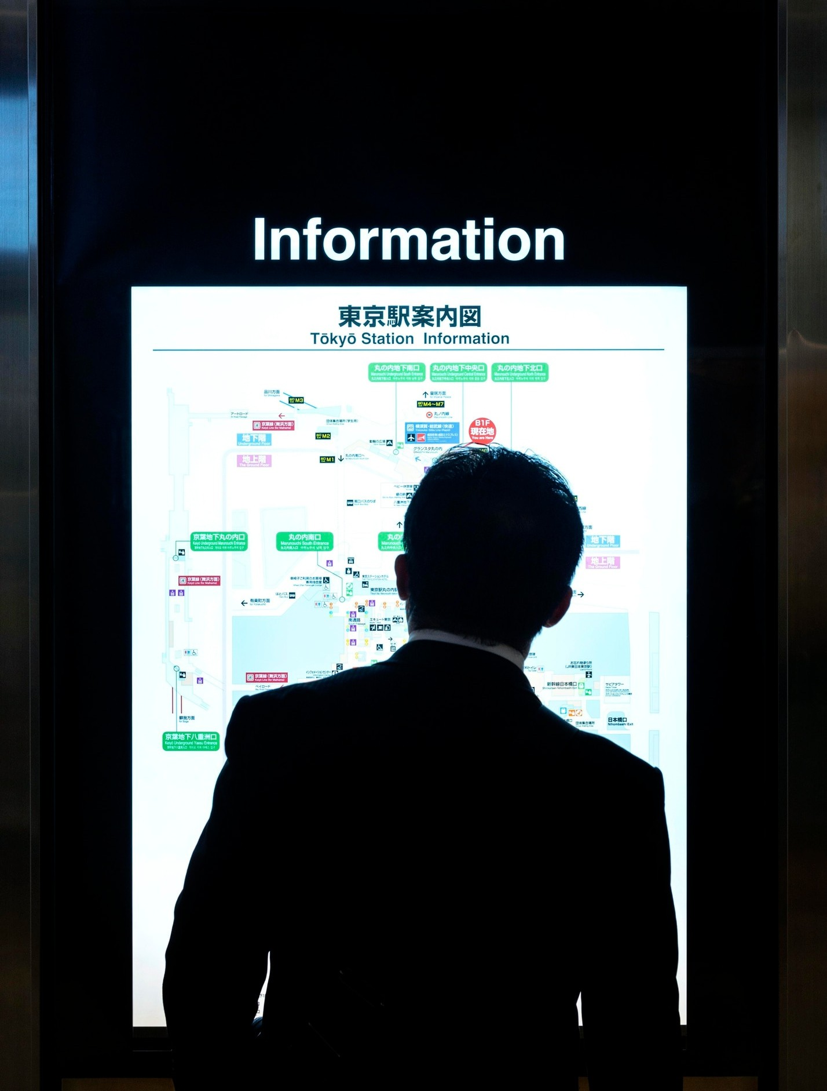
Protecting Your Personal Information
Understand the importance of limiting the personal information you share online and reviewing privacy settings to minimize your vulnerability to phishing attacks.

Slide 11


Educating Others About Phishing
Discover ways to share your knowledge and raise cybersecurity awareness among your family, friends, and colleagues to collectively strengthen the defense against phishing threats.

Slide 12
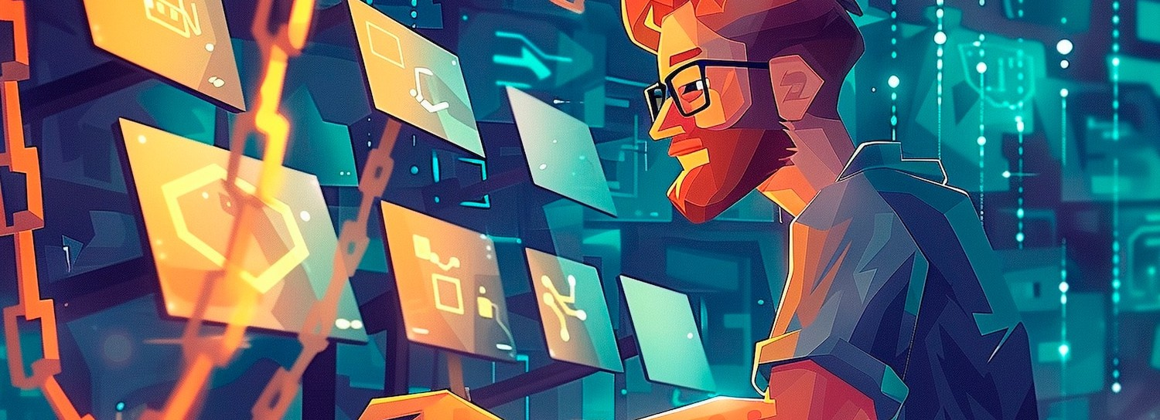
Staying Up-to-Date with Cybersecurity Trends
Explore reliable cybersecurity resources and industry publications to stay informed about the latest phishing tactics and emerging digital security trends.

Slide 13

Conclusion: Empowering Yourself Against Phishing
Summarize the key strategies and best practices covered in this presentation to empower yourself and your community in the ﬁght against phishing attacks.

Slide 14

Thanks!
Do you have any questions?
please feel free to ask! ehtishamOfﬁcials@gmail.com

